Slide 1


DMDD PROJECT
INVENTORY
MANAGEMENT
SYSTEM
Presented by Team Relational Ninjas
Sathyavarthan Balachandar (002207505)
Soumya Ganesh (002812787)
Uttkarsh Bharadia (002872928)
Malini Janaki Sankaran (002816185)

Slide 2
PROBLEM STATEMENT
Due to antiquated manual inventory methods, firms face difficulties including inaccurate inventory and higher holding costs in today's business environment. Challenges include slow order processing, inadequate real-time visibility, and manual restocking procedures leading to potential stockouts. The proposed system seeks to address these issues by offering dynamic inventory tracking, efficient order processing, and automated restocking mechanisms, providing businesses with a competitive edge through enhanced operational agility and improved customer satisfaction.

Slide 3
OBJECTIVE
Enhance Inventory Transparency: Real-time addition of categories and products for seamless stock monitoring and accuracy
Streamline Order Processing: Empower customers to modify orders and add products during the "processing" stage, ensuring efficient fulfillment
Proactive Restocking Mechanism: Automatically generate product supply records for timely reorders, aiding inventory management
Dynamic Pricing and Billing: Apply discounts, calculate final prices, and generate accurate total bills for precise financial transactions
Comprehensive User Management: Allow easy updates to personal information for customers and suppliers, ensuring accurate records
Operational Efficiency: Optimize supplier relationships, minimize holding costs, and prevent stockouts for streamlined operations
Scalable Growth Support: Design for scalable growth, accommodating evolving business needs and facilitating long-term expansion

Slide 4
PROPOSED SOLUTION
PRODUCT MANAGEMENT
AUTOMATED RESTOCKING
DYNAMIC PRICING & BILLING
Adds new product categories and products to the inventory
Monitors product quantity in stock by maintaining a minimum threshold
Applies discounts to selected products and calculates final price and total bill amount
ORDER PROCESSING & MODIFICATION
USER INFO
MANAGEMENT
Places orders, updates quantities, and adds new products to existing orders
Customers and suppliers can update their personal information

Slide 5
BUSINESS RULES
ProductDiscount
Only one discount code can be applied for an order, which again is applied for one product
Category
A product must belong to only one category
Product Reorder
A constant number of quantities is only ordered every time from the supplier. Calculated at the time when the product is created (ReorderQty = QtyInStock – MinQty)
Supplier
The supplier never runs out of stock, which implies products ordered from the ImsAdmin will always reflect the Product table in an increase of quantity.
Order
An order placed cannot be cancelled, Instead the customer can edit the order as per his requirement

Slide 6
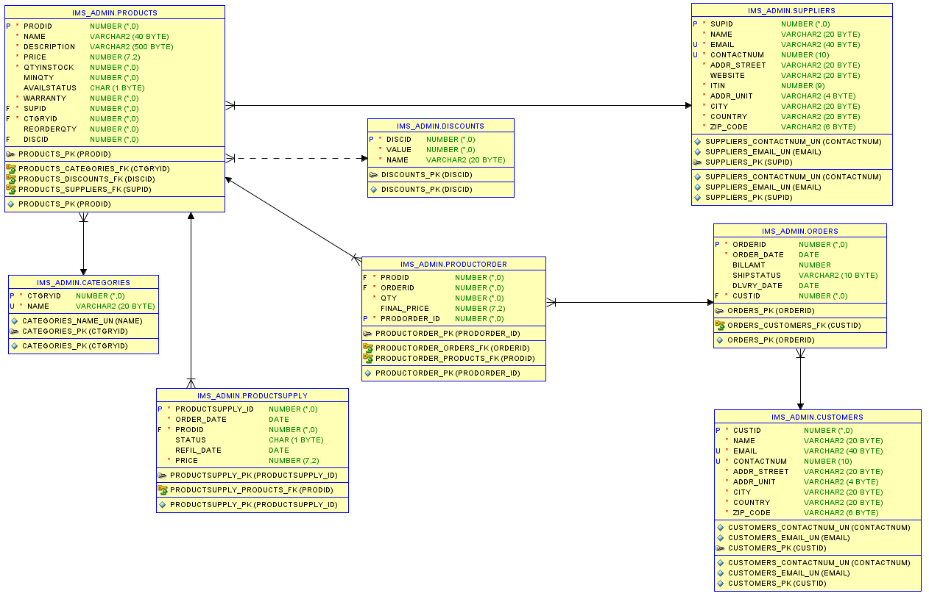
ENTITY RELATIONSHIP DIAGRAM

Slide 7
ENTITIES AND ATTRIBUTES
PRODUCTS
PRODID (Primary Key)
CTGRYID (Foreign Key)
SUPID(Foreign Key)
DISCID(Foreign Key)
NAME
DESCRIPTION
PRICE
QTYINSTOCK
MINQTY
AVAILSTATUS
WARRANTY
REORDERQTY
CATEGORY
CTGRYID (Primary Key)
NAME
DISCOUNT
DISCID (Primary Key)
VALUE
NAME
PRODUCT SUPPLY
PRODUCTSUPPLY_ID(Primary Key)
PRODUCTID (Foreign Key)
ORDERDATE
STATUS
REFIL_DATE
PRICE

Slide 8
ENTITIES AND ATTRIBUTES
PRODUCTORDER
PRODECTORDERID (Primary Key)
PRODID (Foreign Key)
ORDERID(Foreign Key)
QTY
FINAL_PRICE
SUPPLIER
SUPID(Primary Key)
NAME
EMAIL
CONTACTNUM
ADDR_STREET
WEBSITE
ITIN
ADDR_UNIT
CITY
COUNTRY
ZIPCODE
CUSTOMER
CUSTID(Primary Key)
NAME
EMAIL
CONTACTNUM
ADDR_STREET
ADDR_UNIT
CITY
COUNTRY
ZIPCODE
ORDERS
ORDER_ID(Primary Key)
CUST_ID(Foreign Key)
ORDER_DATE
BILLAMT
SHIPSTATUS
DLVRY_DATE
PRICE

Slide 9

DATABASE TABLES
Categories
Orders
Products
Discounts
ProductSupply
Customers
ProductOrder
Suppliers

Slide 10
PROCEDURES
Suppliers
Register supplier
Update supplier information
Refill requests for products
Customers
Insert order
Place product order
Update product quantity in order
Register customer
Update customer information
Retrieve order history of customer
Update total amount in order
IMS Manager
Add product
Update product information
Add discount
Add category
Update availability status of product
Update discount for products
Increase quantity in stock once product is refilled by supplier
Logistic admin
Toggle ship status up from Processing to Delivered stage
Toogle ship status down from Delivered to Processing stage

Slide 11
SECURITY
Procedure-Only Access: Users are restricted to executing stored procedures exclusively
Fine-Grained Procedure Permissions: Implement specific procedure permissions for different user roles
Secure Personal Information Handling: Adhere to industry standards for handling and securing personal information
Automated Stock Monitoring: Proactively identifies and addresses stock situations, reducing the risk of overstock or understock. Automation minimizes human error and ensures timely interventions

Slide 12
ROLES
IMS ADMIN
CUSTOMER
IMSDB ADMIN
SUPPLIER
IMS MANAGER
LOGISTIC ADMIN

Slide 13
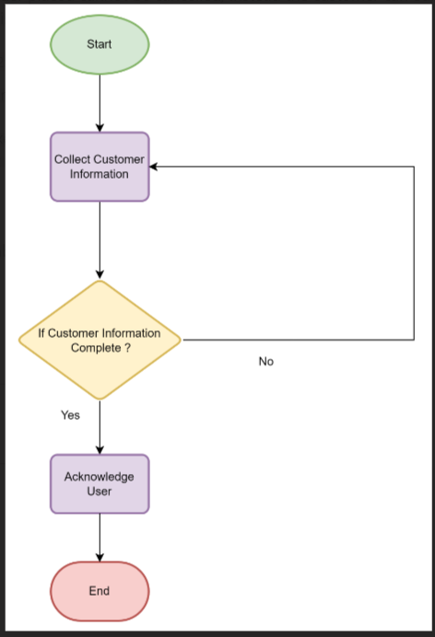
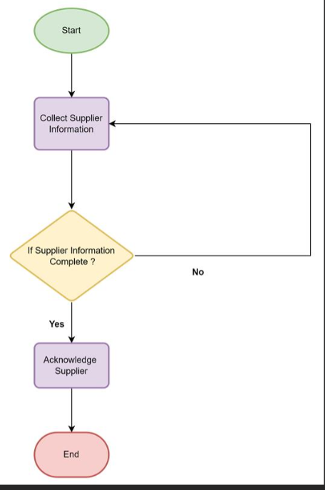
DATA FLOW DIAGRAMS
1. Onboarding a customer
2. Onboarding a supplier

Slide 14
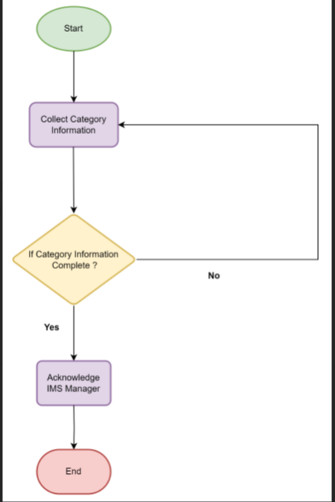
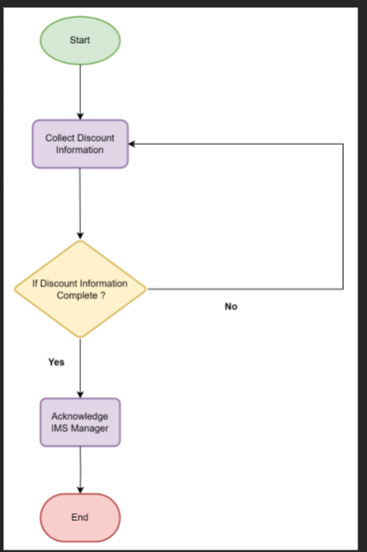
3. Adding a category
4. Adding a discount

Slide 15
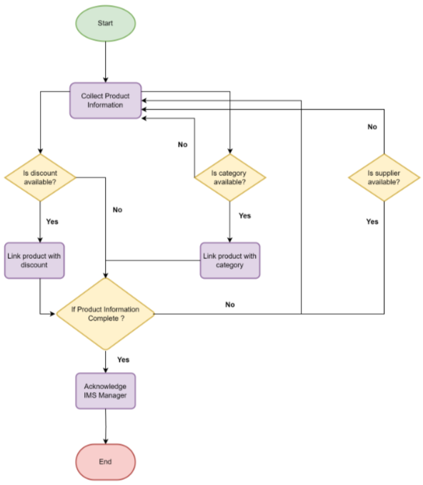
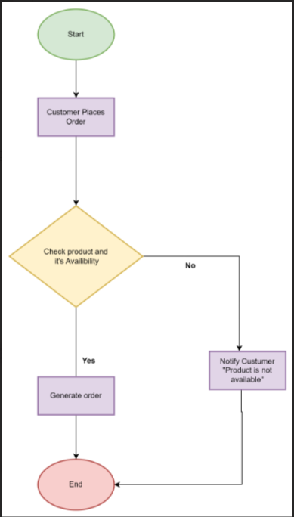
5. Adding a product
6. Placing an order

Slide 16
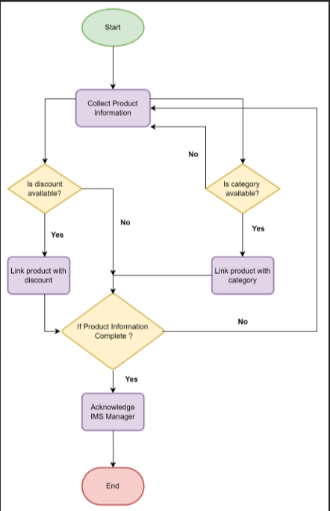
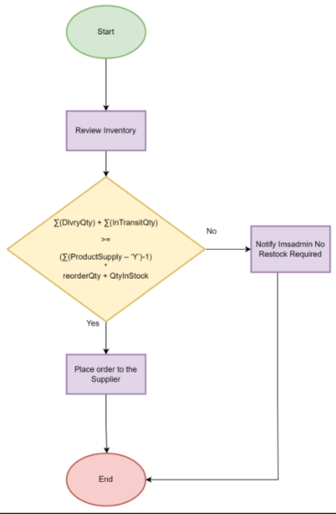
7.Updating an order
8.Reordering inventory

Slide 17
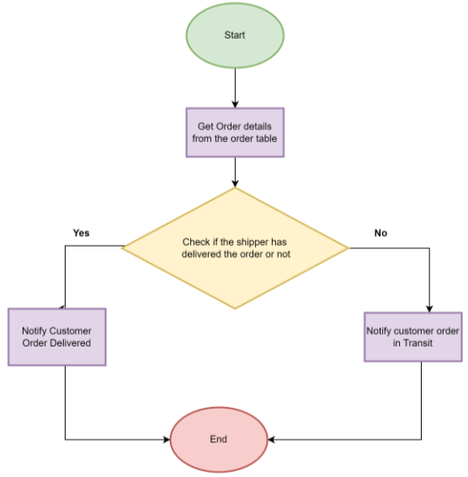
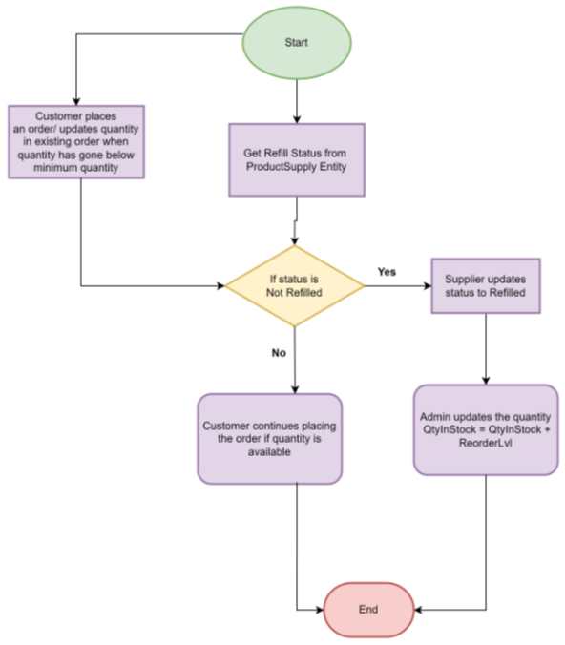
9. Customer view order history
& shipping status of the order
10. Customer able to place order smoothly while the product is running short

Slide 18
REPORTS
Supplier Performance Analysis:
Compares performance of the suppliers based on the quantity of products sold individually which helps in improving the supplier management
Dynamic Stock Overview:
Displays product stock information including the quantity, restock information for each category which helps reducing holding costs, overstock and stockout situations
Product Performance Comparative Analysis:
Provides insight into performance across products of the same supplier

Slide 19
REPORTS
Holistic Sales Insights:
Indicates the total sales based on product, category and customers to improve efficiency and marketing strategy
Seamless Order History Tracking:
Tracks the previous orders placed by customer to facilitate convenience, ease of reordering and serves as a reminder of preferences
Shipping Status Tracking:
Empower logistics administrators to seamlessly track order progress with real-time insights into processing, transit, and delivery statuses.

Slide 20
CONTRIBUTIONS
Sathyavarthan Balachandar demonstrated expertise in enhancing supplier relations by focusing on adding products and streamlining restocking procedures
Malini Janaki Sankaran excelled in customer onboarding initiatives, ensuring a seamless entry for new customers into the system.
Soumya Ganesh played a pivotal role in optimizing the supplier onboarding process, contributing to the efficiency of the overall supply chain.
Uttkarsh Bharadia showcased his skills in customer service by adeptly handling the creation of orders, providing a positive experience for our valued customers.

Slide 21
DEMO

